Slide 1
The Effect of National Measures of Wellbeing on Covid 19 Vaccination Progress
A Data Analysis Project by: Andrew Bly, Jake Burns & Zachary Owen

Slide 2
We expect to find a significant correlation between the rate of successful vaccinations and measures of National Well-being
What is the relationship between fully vaccinated people and economic wellbeing?
What is the relationship between fully vaccinated people and population?
What is the relationship between fully vaccinated people and the nature of health expenditure within that country?

Slide 3
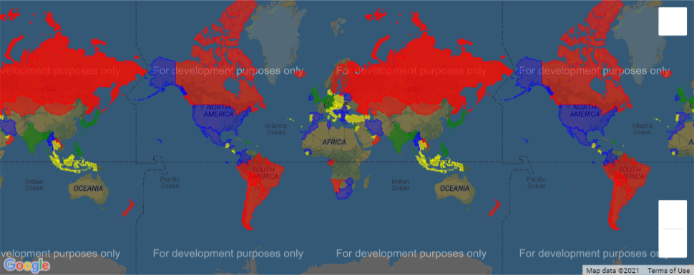
Notes:
Zack will pass it on to Jake after this slide

Slide 4
What data did we need?
Kaggle CSV of world vaccination progress cribbed from the Our World in Data Github Repository
Measures of Wellbeing
Economic
Populace
Educational
Health
Pulled from the World Bank API

Slide 5
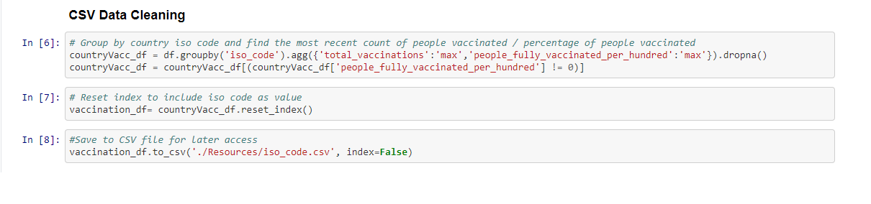
Members of each population fully vaccinated per 100
A CSV was pulled containing data cribbed from the Our World in Data Github Repository
The data was grouped by ISO Code, and aggregated by the Total Vaccinations and People Fully Vaccinated Per Hundred
The data of any countries that did not have any data in the People Fully Vaccinated Per Hundred column was dropped

Slide 6
Data from the World Bank API
Columns were added to the data frame for each variable being analyzed.
A pair of nested for loops were run to cycle through each of the variables and then request the necessary data from the World Bank API
The data was then printed into the data frame
While other measures, such as poverty rate and educational factors, were desirable, four major factors ended up being used
GDP
Total Population
Population Density
Percentage of Health Expenditure in the Private Sector

Slide 7
Insights and Problems
Before cleaning, Gibraltar was most vaccinated
India was the #2 most vaccinated country in terms of number of vaccines administered, however, since their population is so high, they are low in number fully vaccinated per hundred people
After doing the initial extraction an additional CSV was found to add country names to the data frame based on ISO Codes
This allowed the data to be reviewed more easily
Many desired variables were not usable since there was no recent data for them
Much of the poverty related data is only updated once a decade and had not been updated since 2011

Slide 8
Data Analysis
The first step of analysis was to group the data into quartiles based on the different variables being used
From there a One Way ANOVA Test was performed
Null Hypothesis: Each sample mean for indicators broken down by quartile are equivalent
Alternative Hypothesis: There exists one mean such that the sample mean for indicators are not all equivalent
From there, linear regression was performed for each quartile of each variable to look for additional statistically relevant points
Finally, the Top 5 and Lowest 5 countries by both Percent of Population and Number of Vaccinated individuals were separated out
Notes:
Andrew will take over here

Slide 9
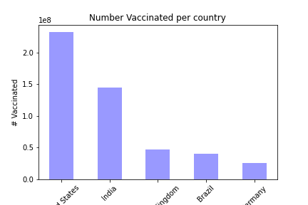
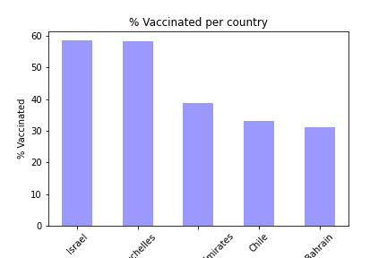
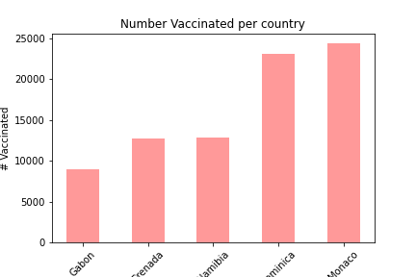
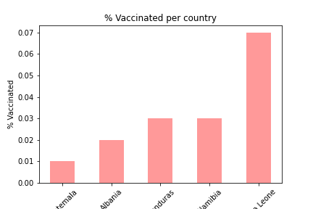

Slide 10
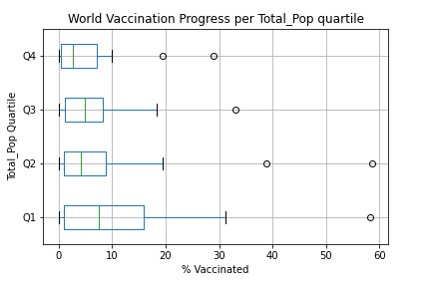
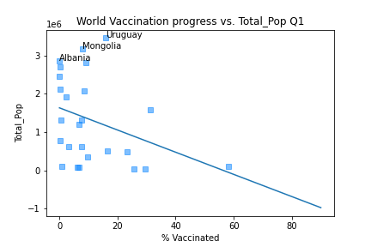
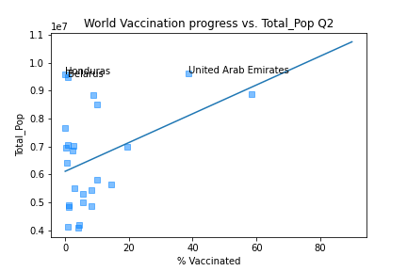
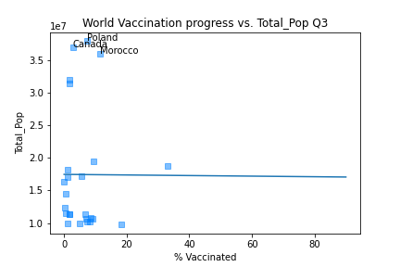
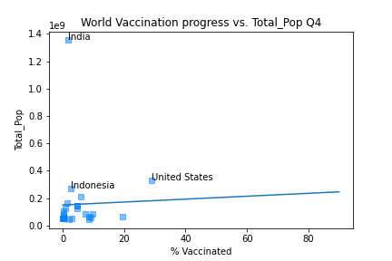
Total Population
This data failed to reject the null hypothesis, thus there is no statistical difference between the data in the different quartiles.

Slide 11
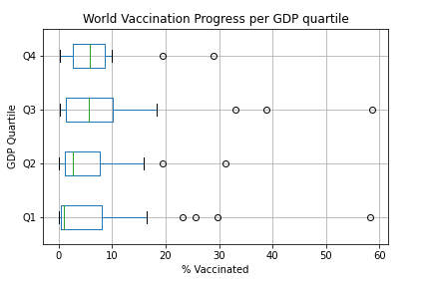
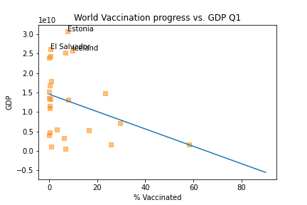
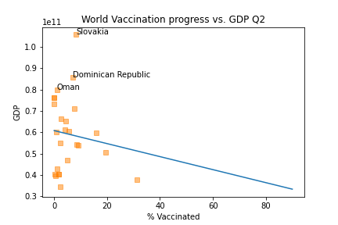
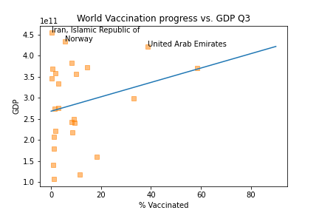
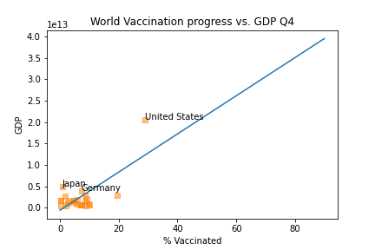
GDP
This data failed to reject the null hypothesis, thus there is no statistical difference between the data in the different quartiles.

Slide 12
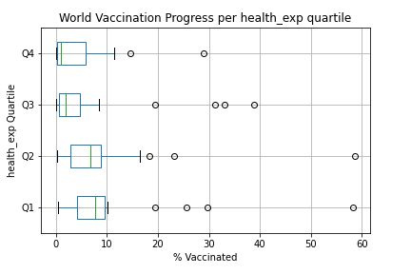
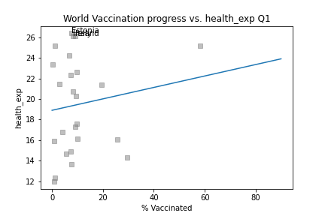
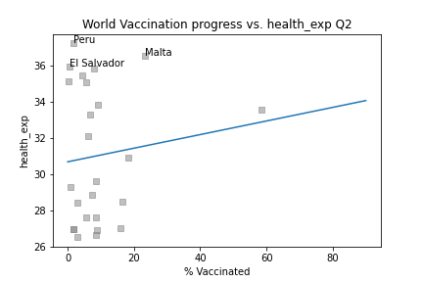
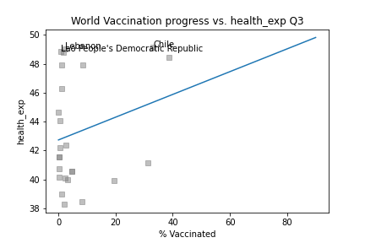
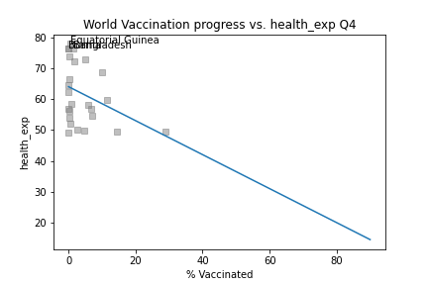
Percent of Health Expenditure in the Private Sector
This data failed to reject the null hypothesis, thus there is no statistical difference between the data in the different quartiles.

Slide 13
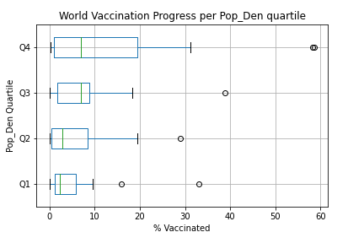
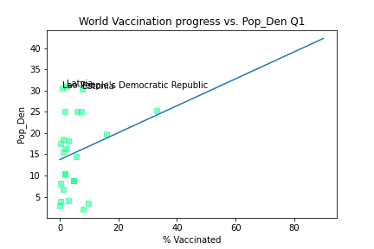
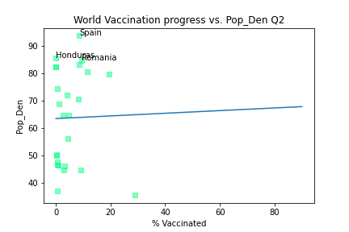
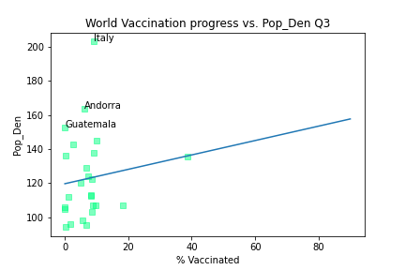
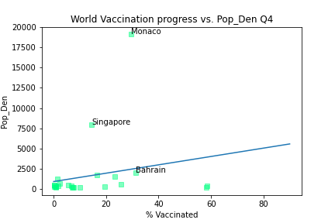
Population Density
This data rejected the null hypothesis, this suggests there is a statistical difference between the data in the different quartiles

Slide 14
Discuss Findings
Based on the GDP scatter plots the r values suggest a relationship, but the ANOVA test did not find any statistically significant relationship
The ANOVA test proved that there was statistically significant difference per quartile based on Population Density
While Private Healthcare Expenditure did not have any statistically significant relationship, that data was very interesting for what it suggested about the effects of Public Healthcare.

Slide 15
Post-Mortem
The biggest struggle was finding data that was relevant to the dates being analyzed
Initially in the analysis, a heatmap was explored to show vaccination progress. The resultant map was not telling the story we wanted, so a Choropleth map was used in its place
With additional time hopefully the census data would be more readily accessible, thus allowing the review of variables like Poverty Rate
Notes:
Zack will take back over

Slide 16
Questions?

